Slide 1
Smart Cap for Visually Impaired

Slide 2
Sl.No. | Lead Proposer | Roll No. | Section
1 | RESU SRISAI KUMAR | 18B81A0251 | EEE-A
2 | ITHERAJU VENKATARAMANA | 18B81A0258 | EEE-A
3 | JHANSI BANURU | 18B81A0220 | EEE-A
4 | RAHUL KOMMULA | 18B81A0237 | EEE-A
Faculty Coordinator(s): Mrs. K. Deepika
Assistant Professor, EEE Department

Slide 3
Contents
Problem Statement
Existing Solutions
Proposed Solution
Uniqueness and Novelty
Operation
Block Diagram and Schematic Diagram
Budget requirements
References

Slide 4
Problem Statement
Visually challenged need to be alerted about the nearness of static or moving objects to protect them from possible accidents.
They need to be directed to orient their path for walking.
Either single or multiple closely located objects need to be identified along any chosen path of travel.
Also, distance of the object from current location needs to be estimated.

Slide 5
Proposed Solution
A smart cap is proposed to help visually impaired people for manoeuvring
This electronic mobility aid is used
To detect static or moving objects
To detect the obstacles in front of them and give the timely alert

Slide 6
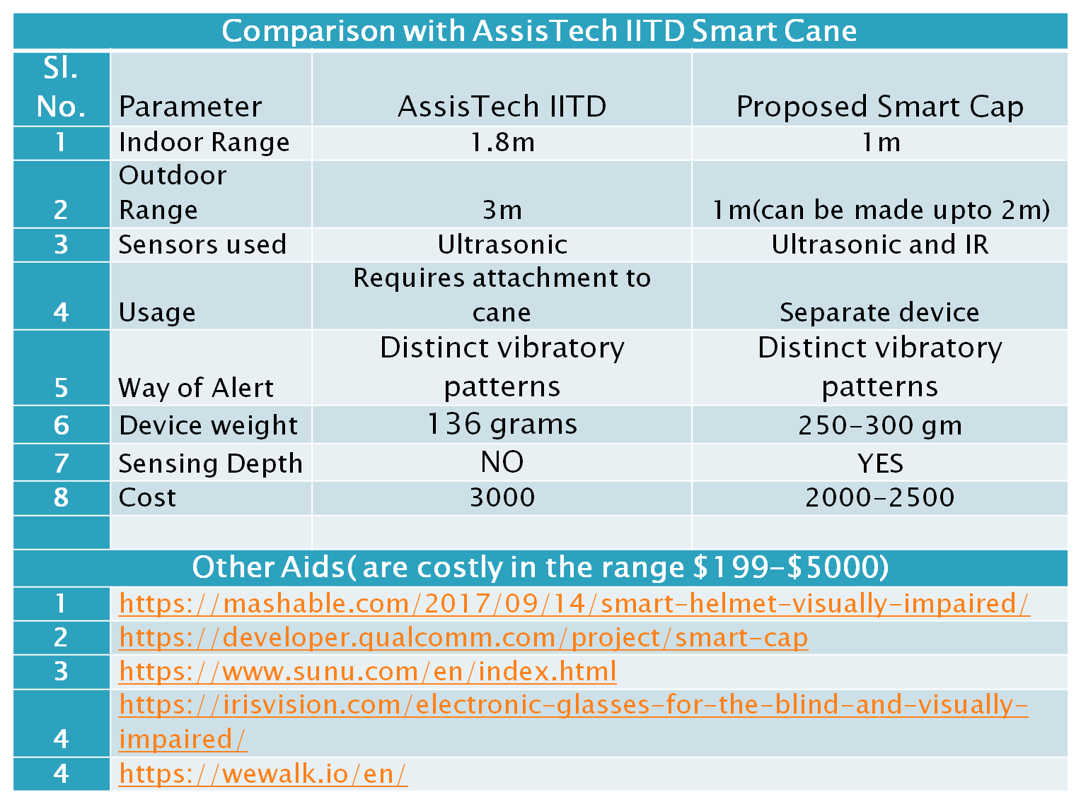
Comparison with existing solution

Slide 7
Uniqueness of Solution
The cap is easily wearable and hands free
The aid looks as a part of attire
Easy handling with extra features to existing solutions using canes

Slide 8
Operation
The concept of obstacle detection is achieved by ultrasonic sensor and infrared sensor.
As soon as the obstacle is detected by the sensors, its distance is sent to the controller.
The controller checks whether the distance of obstacle is less than 1metre and if it is so, the output is sent to the multiple vibrating motors.
The vibration of motors depend on the direction of the obstacle.
The intensity of vibration depending the distance of the obstacle from human.
Minimum Obstacle width that can be detected is 3cm

Slide 9
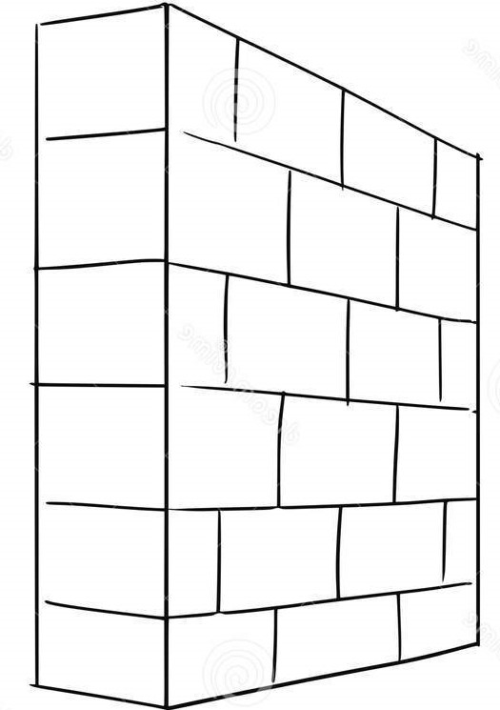

Cap Alerts

Slide 10
Cap Alerts

Slide 11
Cap Alerts

Slide 12
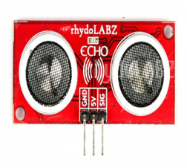
O₁
O₄
R₃
R₄
Oi are objects surrounding the individual
Ri are the distances between respective objects and the individual.
O₂
R₁
R₂
O₃

Slide 13
The above illustration gives the idea of how the smart cap works
The three sensors set which are placed on the cap detect the obstacles
One sensor detects the obstacle in body level like walls,trees ,etc.
And the line of sight of other two sensors will be towards ground
When there is depth difference between these two sensors then the cap alerts the wearer
The intensity of the vibration depends on how close the obstacle is

Slide 14
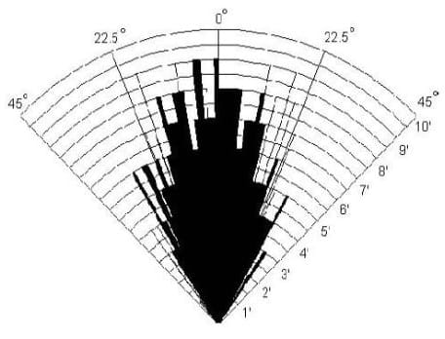
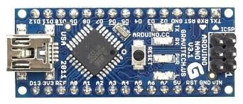
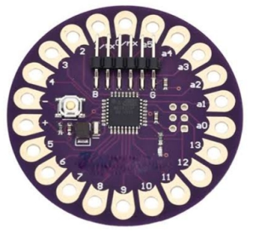
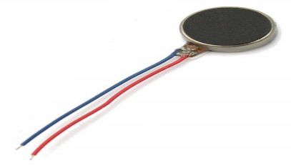
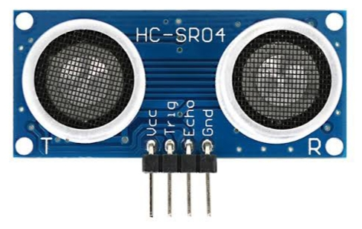
Block Diagram
Microcontrollers,analysing the data
Vibrating the motors based on data
Vibrating Motor
Size:10mm,2.8mm
Rated Voltage:1v-4v
Current:66mA
Output speed:-1200rpm
Cable length:2cm/0.79
Net weight:1 gram
Arduino nano
No of digital pins: 14 (6 used)
No of analog pins: 8 (0 used)
Dimensions : Length : 45mm
Width : 18mm
Arduino Lilypad
No of digital pins:14 (6 used)
No of analog pins:6 (0 used)
Dimensions : Diameter-50mm
Width - 3mm
Ultrasonic sensor block
Dimensions:length:43mm
Width:15mm
Range:Available:5m
Require:1.5m
Echo Signal
output
Trig Signal

Slide 15
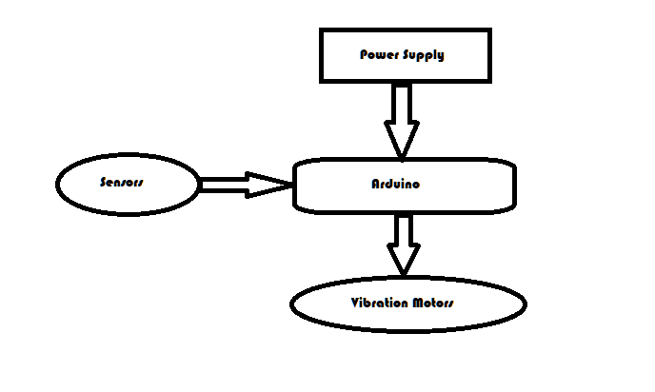

Slide 16
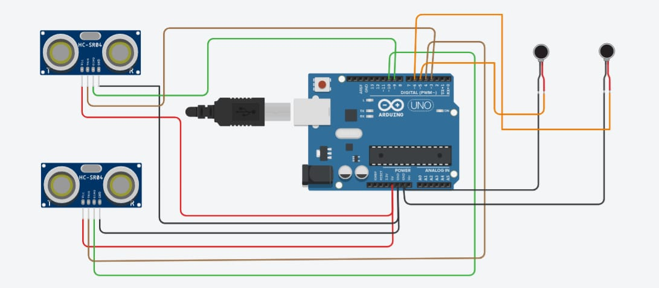
Schematic Diagram

Slide 17
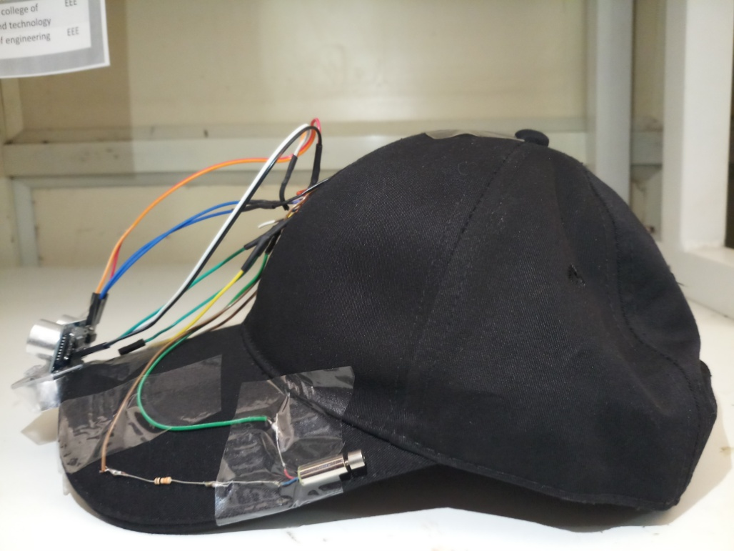
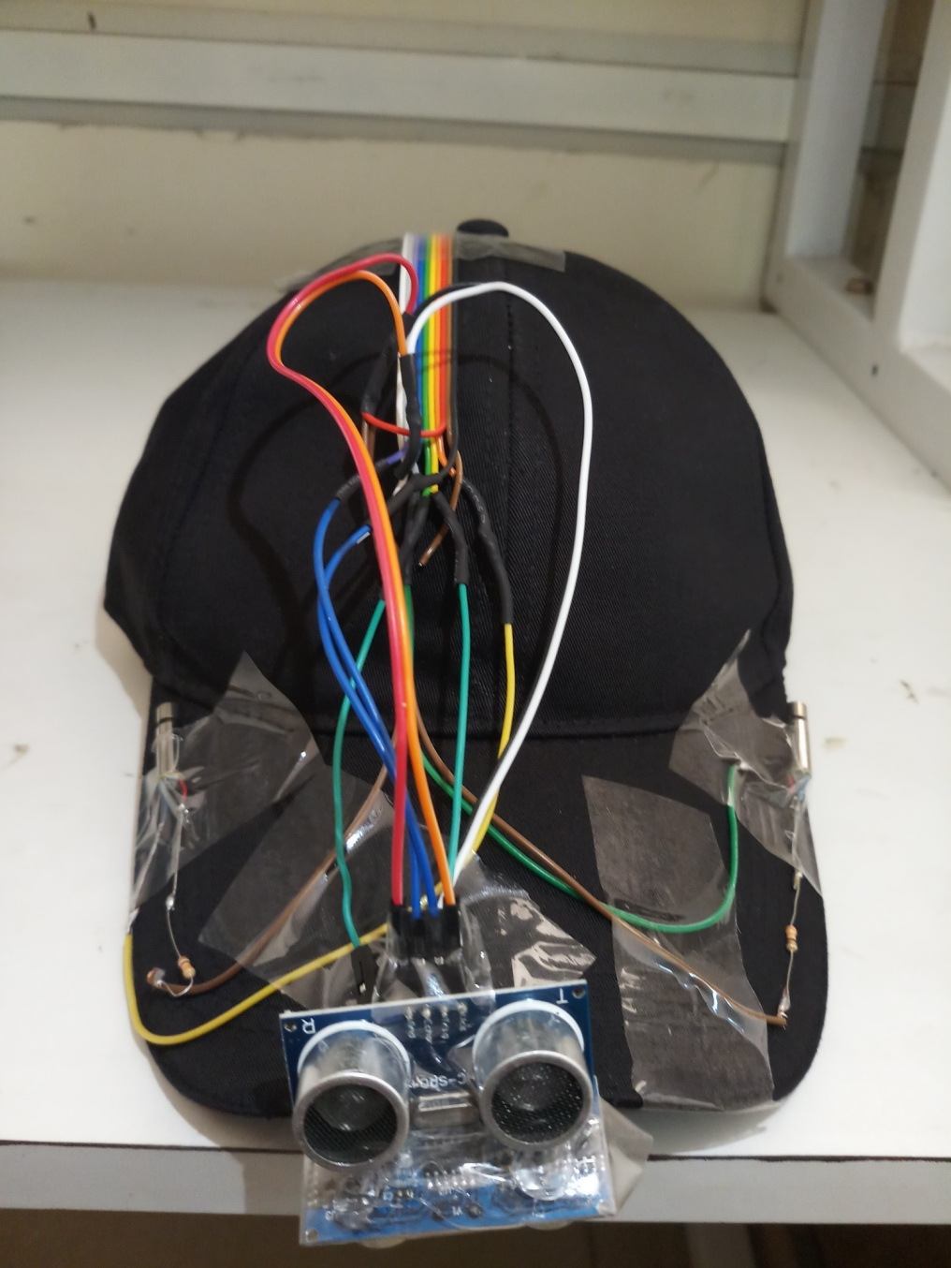
Prototype-1
Front and side view of the prototype made using the arduino lillypad microcontroller.

Slide 18
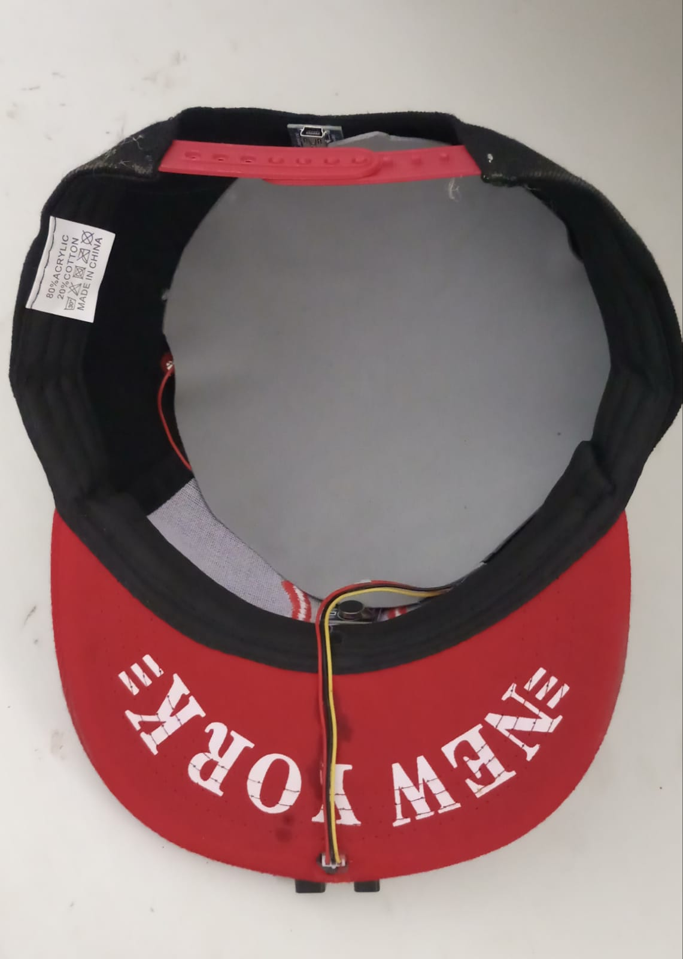
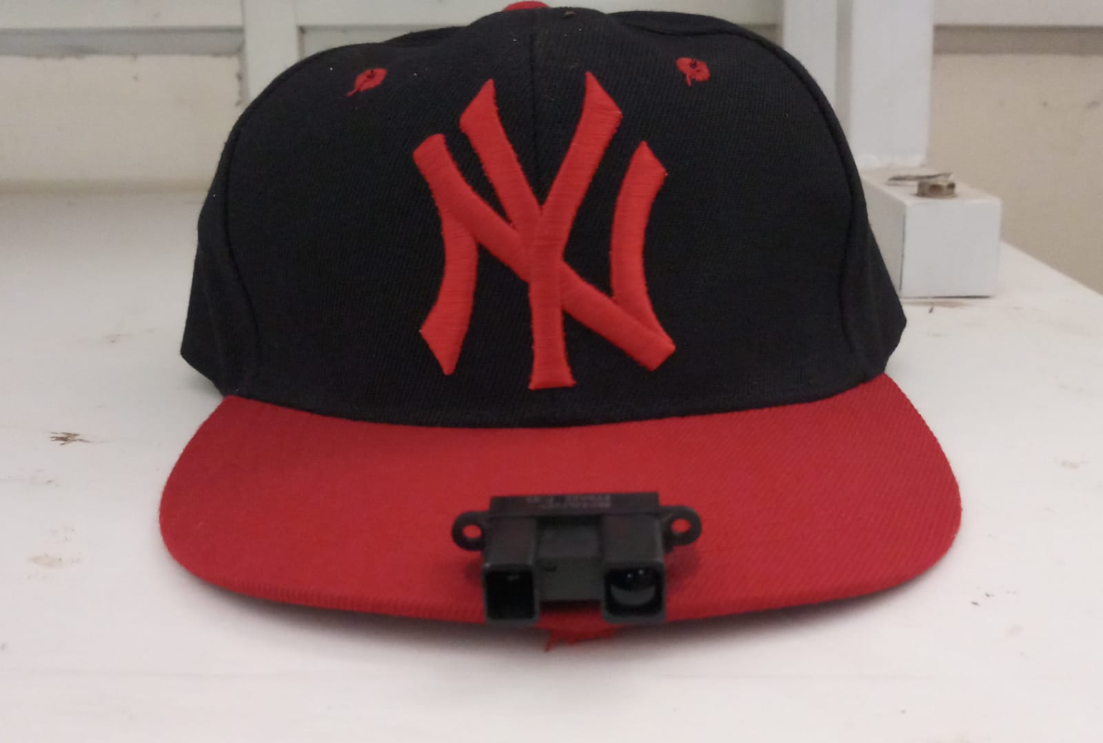
Prototype-2
Front and top view of the prototype made using the arduino uno microcontroller.

Slide 19
Materials used
Microcontroller
Arduino Nano
Arduino Lilypad
UltraSonic Distance Sensor
Sharp IR Sensor
Lithium Polymer Battery
5V Charging Module
3V Vibrating mini motor disc

Slide 20
Conclusion
To reduce the size and cost of the product instead of microcontrollers,microprocessers like Attiny85 and Atmega328 processers are to be used.
The asthetics of the cap are to be improved.
Ultrasonic sensors are having high measuring angle(15˚) which can cause errors so we are testing with other sensors like sharp infrared sensor and TFmini sensor.

Slide 21
References
Battery Operated Cane
https://www.maxiaids.com/ray-electronic-mobility-aid-for-the-blind
http://www.technologybloggers.org/technology/smart-canes-for-the-blind/
Ultrasonic Sensor Distance Measurement
https://www.rhydolabz.com/wiki/?p=895
Arduino Nano
https://www.arduino.cc/en/pmwiki.php?n=Main/ArduinoBoardNano
TFMini-Micro LiDAR Module
https://robu.in/product/tfmini-s-micro-lidar-distance-sensor/
Sharp IR Sensor
https://robu.in/product/sharp-distance-measuring-sensor-unit-20-150-cm-gp2y0a02yk0f/
Ultrasonic Sensor Distance Measurement
https://www.rhydolabz.com/wiki/?p=895

Slide 22
Thank You

